Slide 1
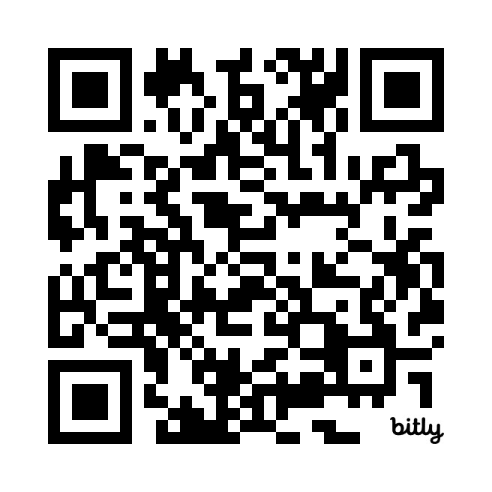
Introduction to Software Requirements Quiz
https://bit.ly/3TQ65RO

